Slide 1
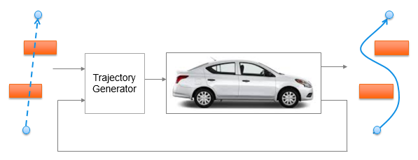
Trajectory Generation in High Density Environment
Mid-Term Review
Suvo Ganguli
Alberto Speranzon
Feb 2018

Slide 2
<number>
Overview
Trajectory Generation in 2-dimensional space
Laplacian Planner
Model Predictive Control (MPC)
Tradeoff Parameters
Tradeoff Data and Charts
Summary

Slide 3
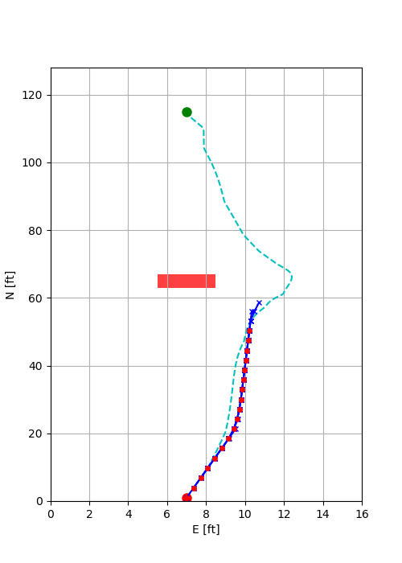
<number>
Trajectory Generation
There are two steps to the trajectory generation:
Laplacian Planner Trajectory Generation
Solves for a potential flow from start point to end point avoiding obstacles
Does not take into account vehicle dynamics and constraints
Provides an initial solution for the MPC Trajectory Generator
MPC Trajectory Generation
Solves an optimization problem to generate a short trajectory
Moves one step along the trajectory and resolves the optimization problem
Takes into account vehicle dynamics and constraints

Slide 4
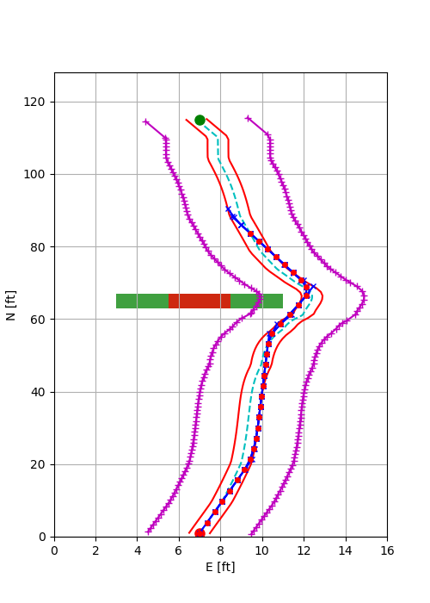
<number>
MPC Trajectory Generation
Minimize cost
Velocity error
Lateral path error
Control signals
Satisfy vehicle dynamics and constraints
Satisfy other constraints
Trajectory constraints
Terminal constraints
Lateral Acceleration constraint
Laplacian trajectory
Terminal constraints
Obstacle
Safety Margin
Trajectory constraints
MPC trajectory

Slide 5
<number>
Overview
Trajectory Generation in 2-dimensional space
Laplacian Planner
Model Predictive Control (MPC)
Tradeoff Parameters
Tradeoff Data and Charts
Summary

Slide 6
<number>
Tradeoff Parameters
Our goal is to trade off the CPU time (CT) with
Trajectory Parameters
Number of MPC time steps = N
MPC time step = T
Model Complexity
Number of states = ns
Obstacle density
Number of obstacles = no
Model Complexity
2 states model
4 state model
6 state model
Obstacle Density is measured by the number of obstacles which are
Static
Placed to obstruct the line of sight from the start point to the end point
CT
vs
N | T (sec) | ns | no
4 | 0.2 | 2 | 0
6 | 0.4 | 4 | 1
8 | 0.6 | 6 | 2

Slide 7
<number>
Model Complexity
2 state model
4 state model
6 state model

Slide 8
<number>
Overview
Trajectory Generation in 2-dimensional space
Laplacian Planner
Model Predictive Control (MPC)
Tradeoff Parameters
Tradeoff Data and Charts
CPU time vs Number of Obstacles (CT vs no)
Summary

Slide 9
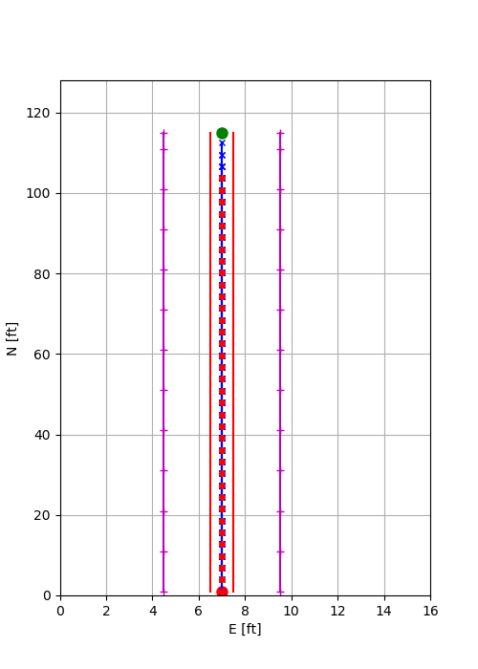
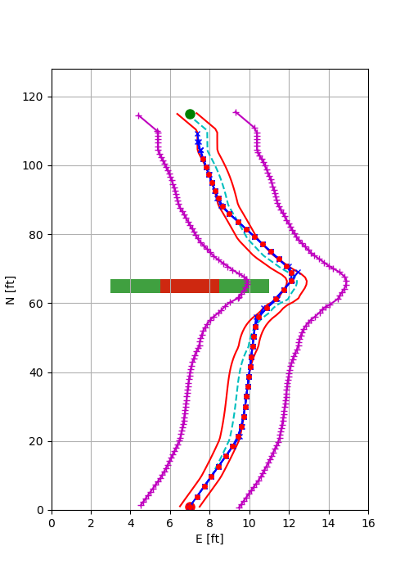
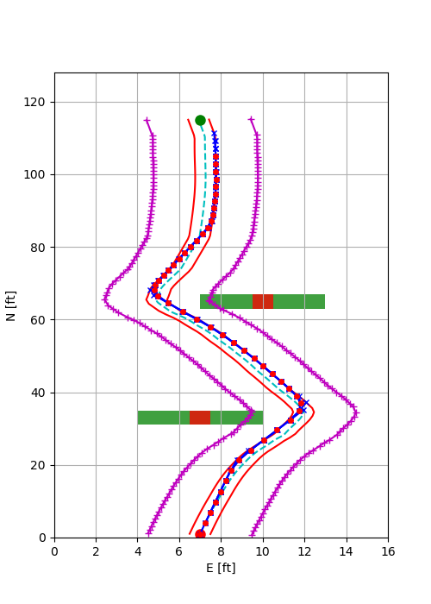
<number>
MPC Trajectory in Presence of Obstacles
MPC Trajectory Generator successfully generates path between the start and end point in presence of obstacles
N = 4, T = 0.4, ns = 4
No Obstacle
1 Obstacle
2 Obstacles

Slide 10
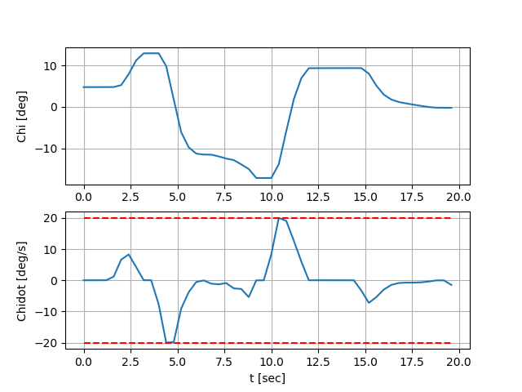
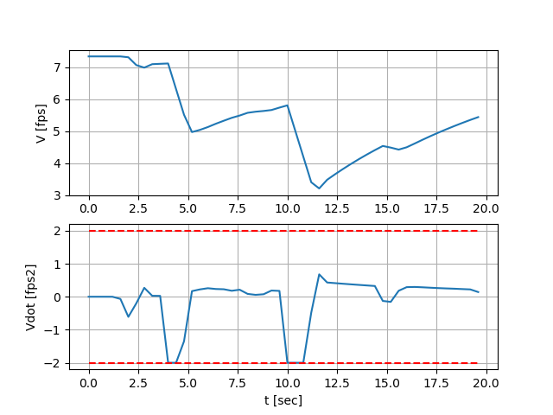
<number>
MPC Trajectory Satisfies Vehicle Constraints
N = 4, T = 0.4, ns = 4, no = 2
Corresponds to the turns to avoid the two obstacles

Slide 11
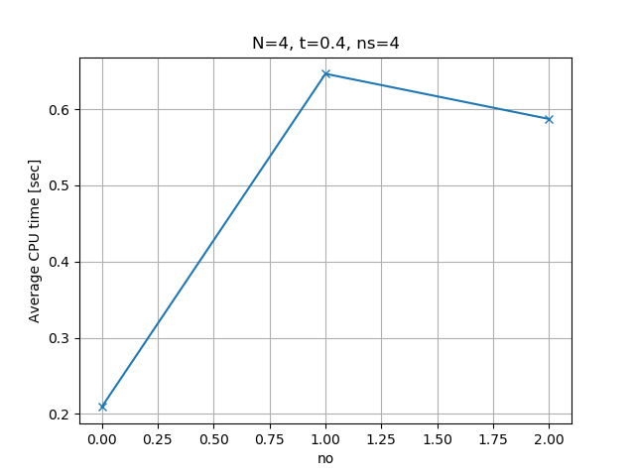
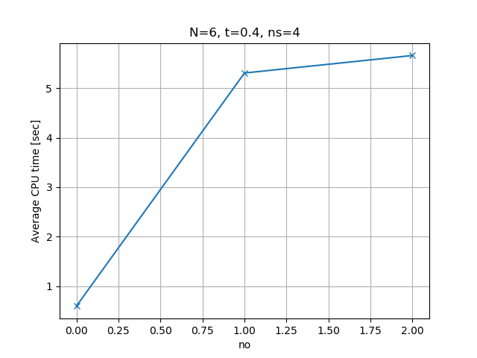
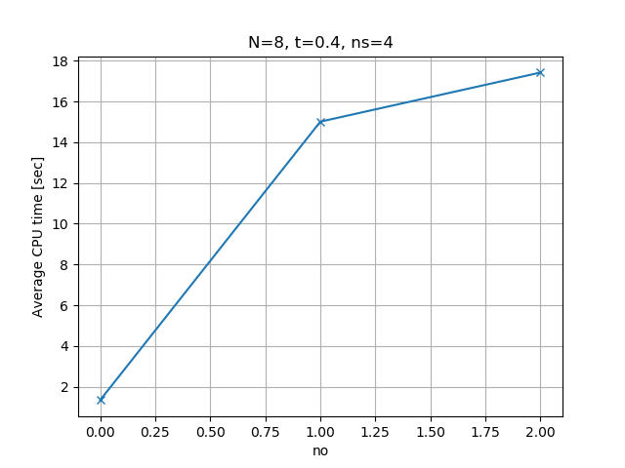
<number>
CPU Time vs Number of Obstacles (CT vs no)
Average CPU time increases (in general) with the number of obstacles
Average CPU time is increases with the number of MPC time steps
3x
9x
11x

Slide 12
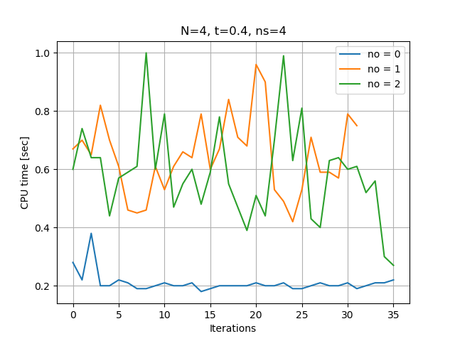
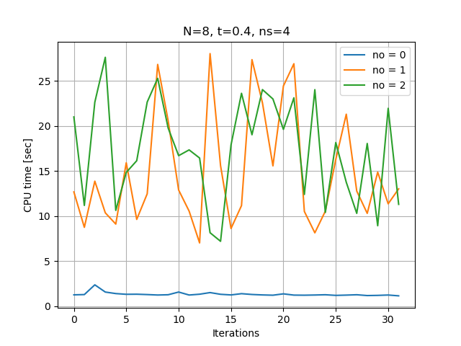
<number>
CPU Time vs Number of Obstacles (CT vs no)
CPU Time varies with the number of iterations. So, averaging over several runs will be more representative of CT vs no.
In case of N = 4, the trajectory generator hits less constraints once it passes the 2nd obstacle (due to the shorter horizon). This leads to slightly less average CT compared to the case with 1 obstacle.

Slide 13
<number>
Overview
Trajectory Generation in 2-dimensional space
Laplacian Planner
Model Predictive Control (MPC)
Tradeoff Parameters
Tradeoff Data and Charts
CPU time vs Number of Obstacles (CT vs no)
CPU time vs Number of Time Steps (CT vs ns)
Summary

Slide 14
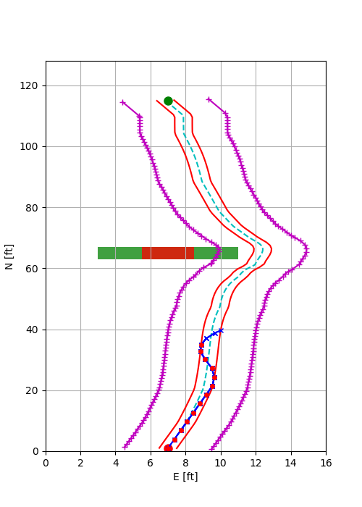
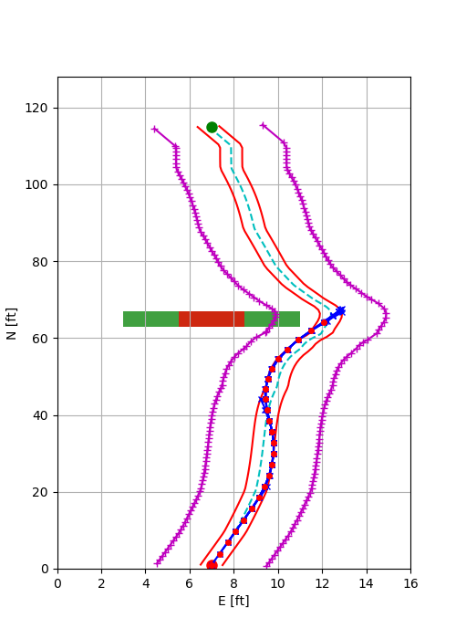
<number>
CPU Time vs Number of States (CT vs ns)
With number of time steps = 4, and number of states = 4, we get instability. This is due to relatively shorter horizon. Plus, the control is instead of which results in slower response.
With number of time steps = 4, and number of states = 6, the trajectory cannot negotiate the turn. This is due the relatively shorter horizon (N).
ns = 4
ns = 6

Slide 15
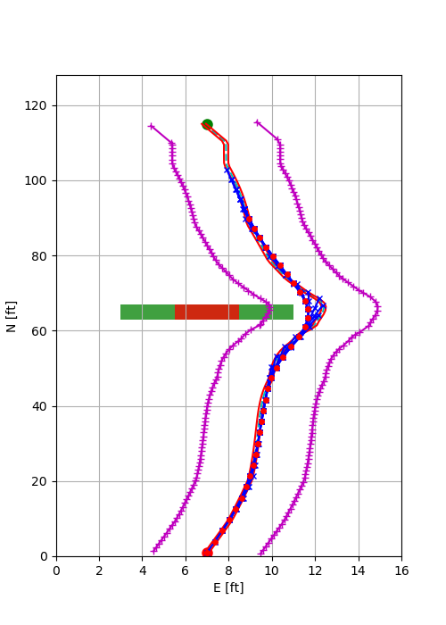
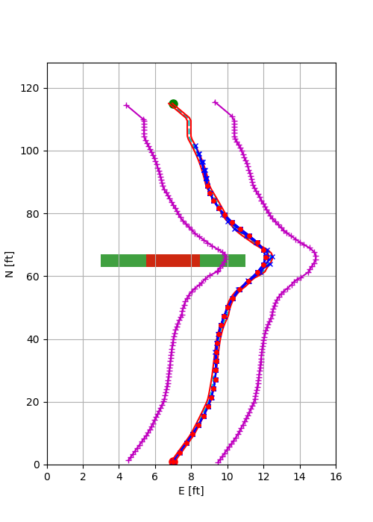
<number>
CPU Time vs Number of States (CT vs ns)
With number of time steps = 4, and number of states = 4 and 6, we can reach the end point when we make the following changes:
Reduce the lateral error margin for the terminal point
Add a terminal velocity constraint
ns = 4
ns = 6

Slide 16
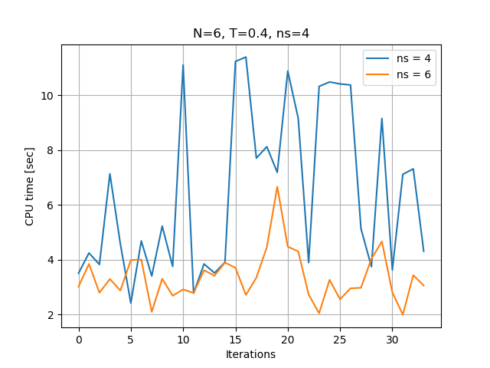
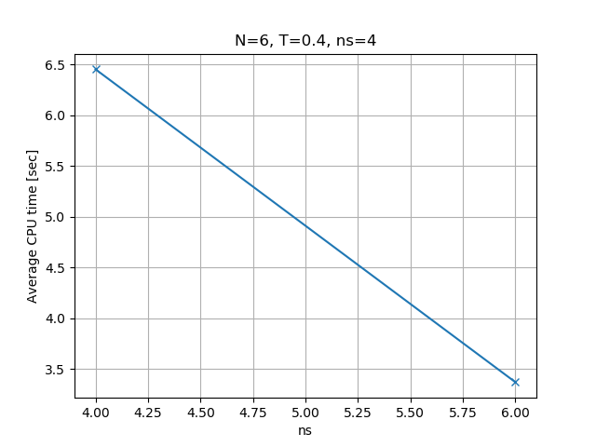
<number>
CPU Time vs Number of States (CT vs ns)
The CPU time is less for ns = 6 as compared to ns = 4. This is counter-intuitive and needs to be studied further.
Initial thought:
Trajectory with ns = 6 is smoother and hits less constraints.
But that doesn’t seem quite right (see next two slides)

Slide 17
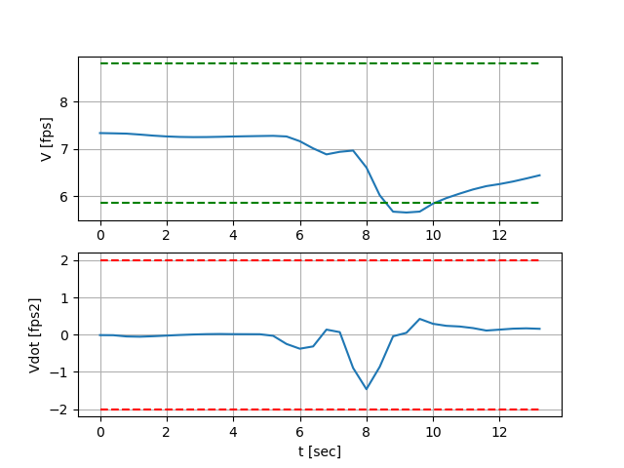
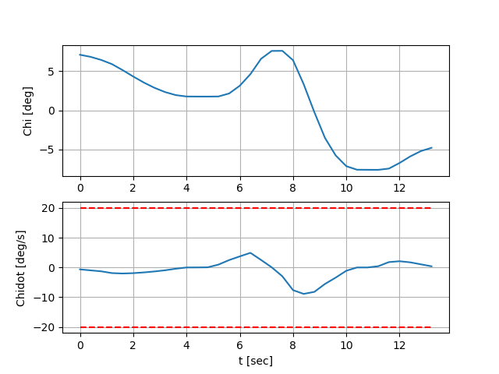
<number>
Constraints for Number of States = 4
Path constraints are almost always active due to the narrow terminal constraint on lateral error.
Constraint on terminal velocity seems to be active during the 2nd turn only.
current velocity
terminal velocity constraint

Slide 18
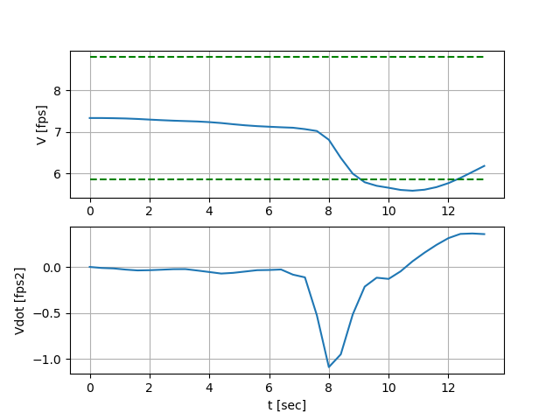
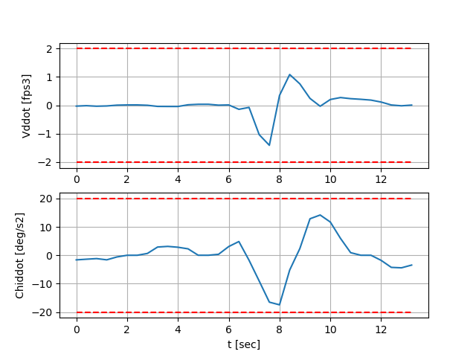
<number>
Constraints for Number of States = 6
Path constraints are almost always active due to the narrow terminal constraint on lateral error.
Constraint on terminal velocity seems to be active during the 2nd turn only.
current velocity
terminal velocity constraint
Notes:
Honeywell Internal
<number>

Slide 19
<number>
Summary
CPU Time (CT) increases with increase in number of obstacles (no) and number of time steps (N). This is expected.
CPU Time (CT) decreased with increase in number of states. This is unexpected. This needs to be studied further.

Slide 20
<number>
Pictures

Slide 21

<number>
Title Slide Picture
Trajectory Generator

